Slide 1
Urry Group Weekly Update
June 7th 2017

Slide 2
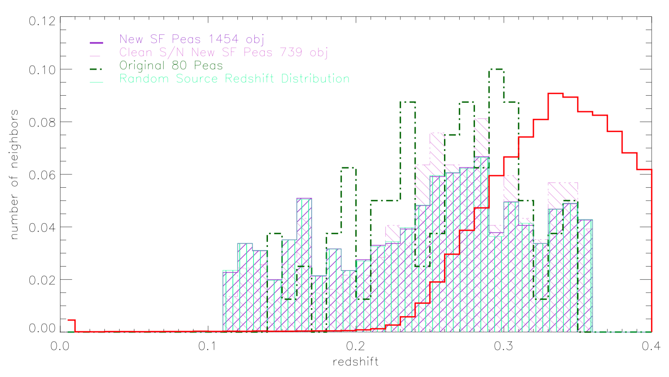
Luminous Red Galaxies, z overlaps, but doesn’t match distribution

Slide 3
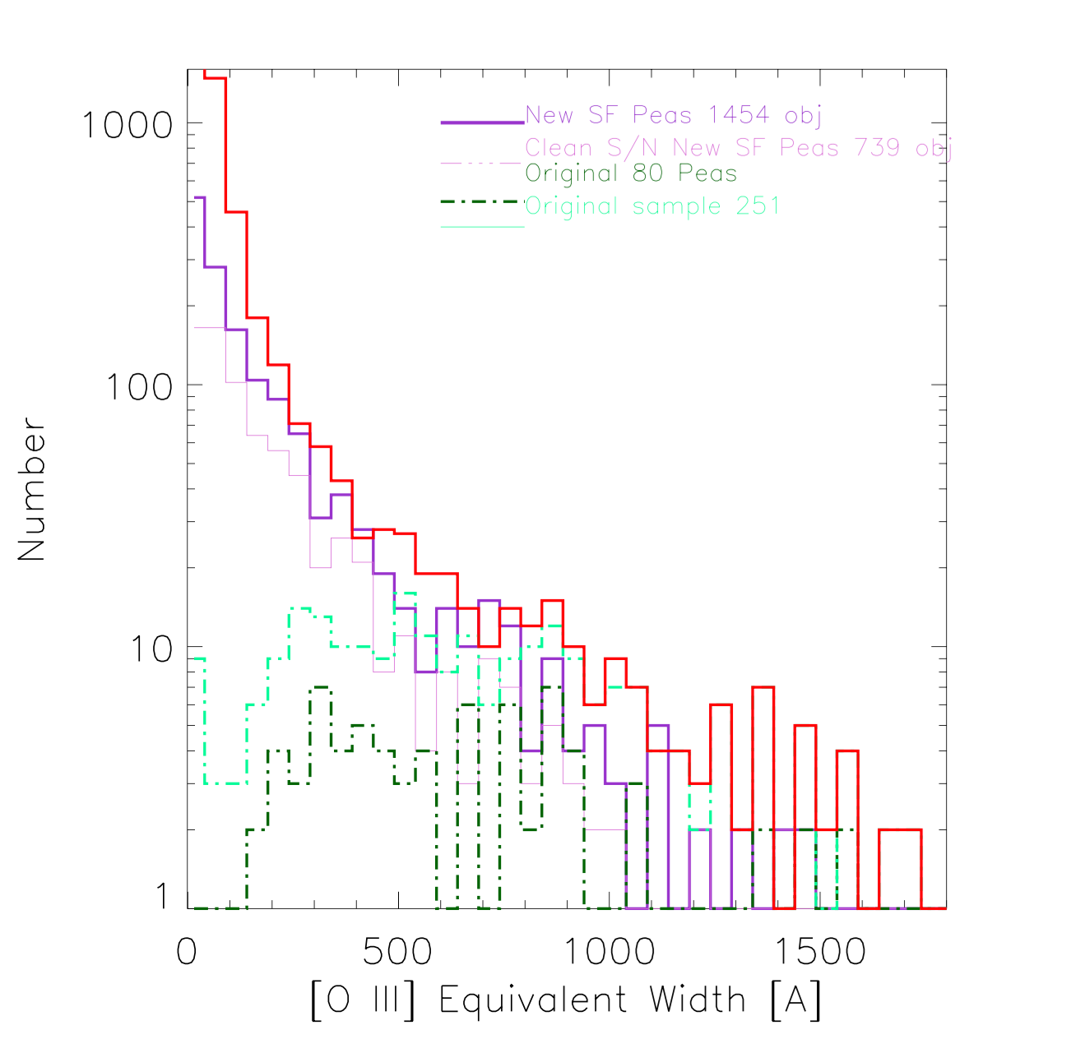
Peas Search in DR12 (2nd number W/ EW of OIII > 10)
DR12 (color & size): 4155
DR12 Portsmouth Group: 2203 1573
DR12 Portsmouth Group SF: 1592 1268
DR12 Portsmouth Group SF & clean phot: 1454 1191
DR12 A/N gt 3 in all lines: 739 686
original 80 peas smallest OIII EW is 12.6
New Peas follow more galaxy-like distribution of OIII

Slide 4

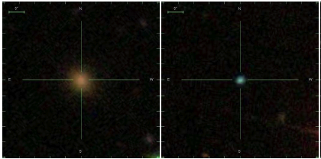
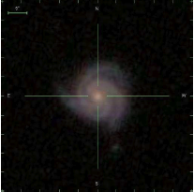

Carie Cardamone Assistant Professor of Astronomy Wheelock College
Active Galactic Nuclei
Green Peas & Galaxy Evolution
- Cardamone et al. 2009
Notes:
Galaxy Zoo: Bars & the Secular Evolution of AGN
Many theories predict the importance of secular feeding of nuclear activity in AGN, some highlighting bar features that can drive gas towards the galactic center. However, a large number of studies have produced highly contradictory results in attempting to find clear connections between the presence of nuclear activity and bar features in galaxies. Galaxy Zoo provides statistically robust morphological classifications for galaxies from a large variety of surveys, including searching for presence of bar features. In the local Universe, 0.01<z<0.05, using a volume limited sample of galaxies from the SDSS survey, we find that both the presence of an AGN and that of a large scale bar is closely tied to a galaxy’s integrated color and mass. While there is still a slight enhancement in the AGN fraction of barred vs unbarred galaxies in bins fixed by mass and color, there is no evidence that barred AGN have a higher accretion rate (as measured by L[OIII]/M_BH) when compared to unbarred AGN. Looking beyond the local universe, 0.2<z<1.0, Galaxy Zoo combines the HST data from AEGIS, COSMOS and GOODS to search galaxies for large scale bar features. Using X-ray data to detect evidence of AGN activity, the data shows that the AGN host galaxies show no significant enhancement in bar fraction or average bar-likelihood as compared to closely-matched inactive galaxies. Taken all together, these results show that large-scale bars are not likely to play a large role in the fueling of moderate luminosity AGN since z~1.

Slide 5
To Dos:
Write up what I did this summer – in progress
DR13 neighbors (spec, phot, photo-z) 1 Mpc – done!
Start learning compute.sciserver.org (Read in a catalog from casjobs) – not started
Matched sample – in progress

Slide 6
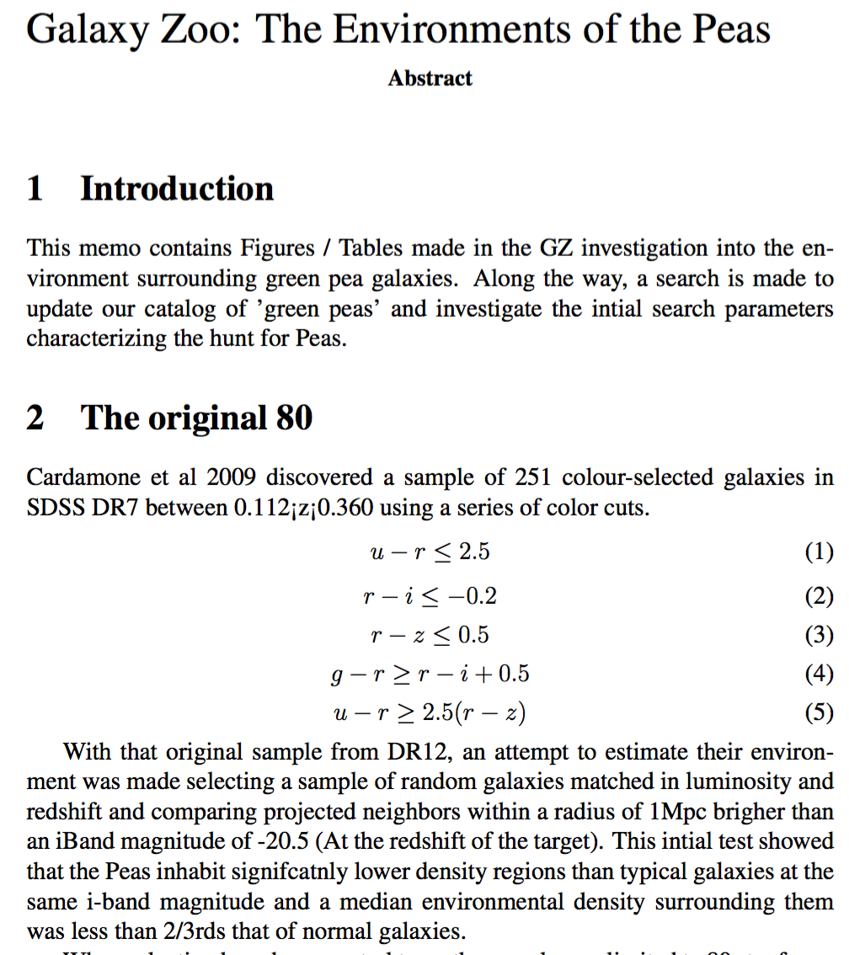
Write up what I did this summer – in progress

Slide 7
Finding Neighbors
Median (z, original 80 peas) = 0.275
Angular Scale distance is 871.7 Mpc (per radian) or 0.004226 Mpc/”
So 1 Mpc = 236” on the sky
I had this too small previously!

Slide 8
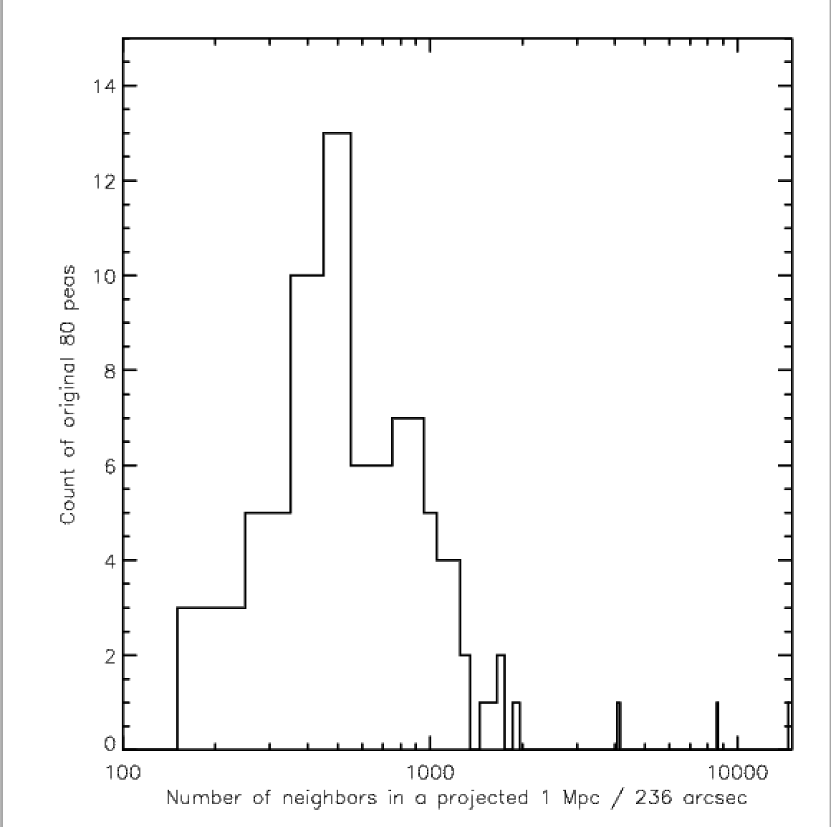
Finding Neighbors
88258 objects near the origional 80 peas
This means 100s by each pea

Slide 9
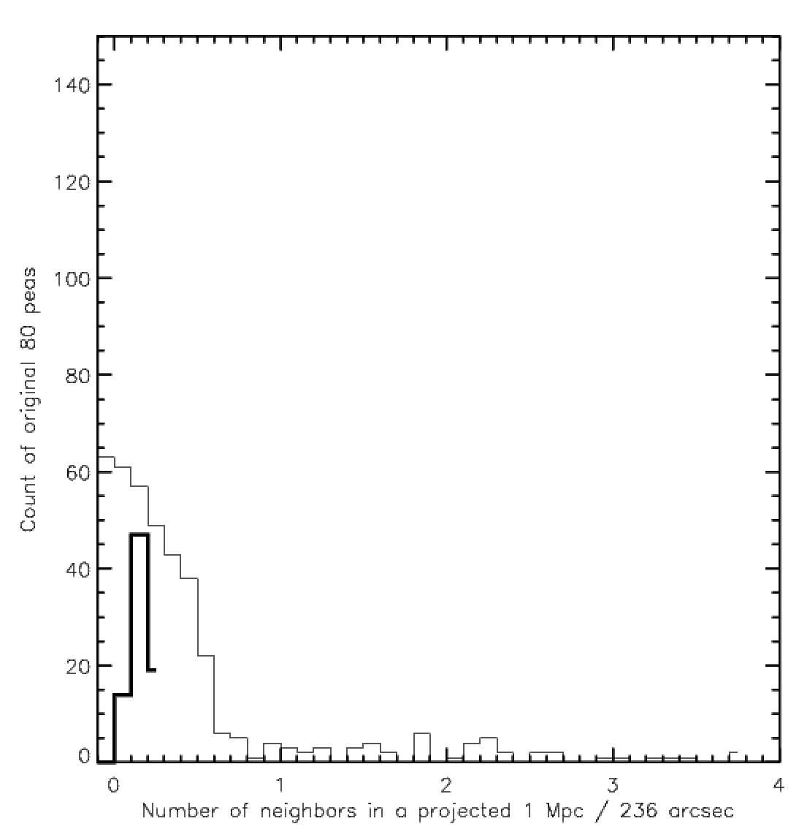
Finding Neighbors – still no speczs
88258 objects near the origional 80 peas
ONLY 351 w/ spectra
Only 45 within +/- 0.1 z_pea

Slide 10
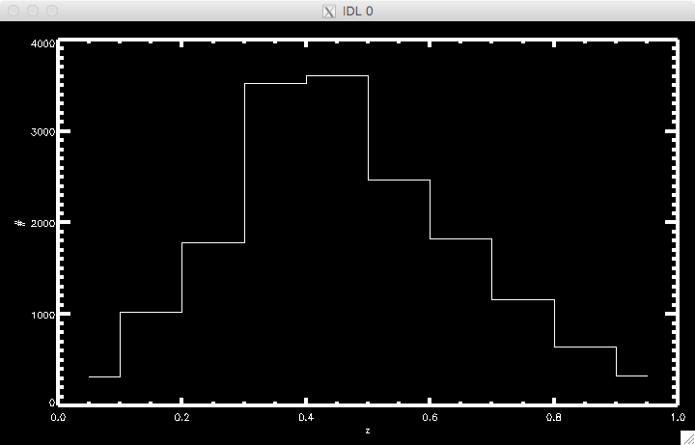
Finding Neighbors – looking for photoz
Of the 88k objects near the origional 80 peas
ONLY 17k have photoz’s

Slide 11
Finding a comparison sample
In spec catalog – NONE near in redshift & z_mag
Searching photoz catalog

Slide 12
Also, try palomar?
Search near Peas?
Deadline Sept.

Slide 13
Todos
Family picnic in NY!!!
Classes start!
Write proposal
Finalize matched-sample, and build distribution of neighbors within 1 Mpc

Slide 14


Slide 15
HST Search - PEAS
63 of the 1346 ‘new’ BOSS peas are in HST imaging + 11 of the 24 original peas not in BOSS search result
Trying to get actual data now….
Recent proposals:
Lyman alpha escape in Green Pea galaxies (give peas a chance)
Green Pea Galaxies: Extreme, Optically-Thin Starbursts?
UV Spectroscopy of Lyman Break Galaxy Analogs: A Local Window on the Early Universe
Origin of double peaks in Lyman-alpha spectra: diffuse halos or Lyman continuum leakage?
Unveiling the Dark Baryons II: the First Sample of OVI Emission Imaging
UV Snapshot of Low-redshift Massive Star-forming Galaxies: Searching for the Analogs of High-redshift Clumpy Galaxies

Slide 16
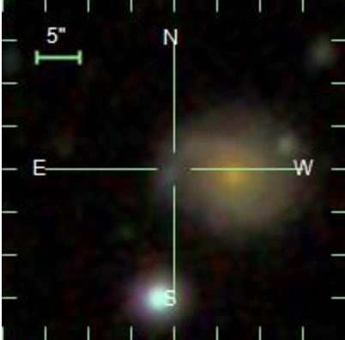
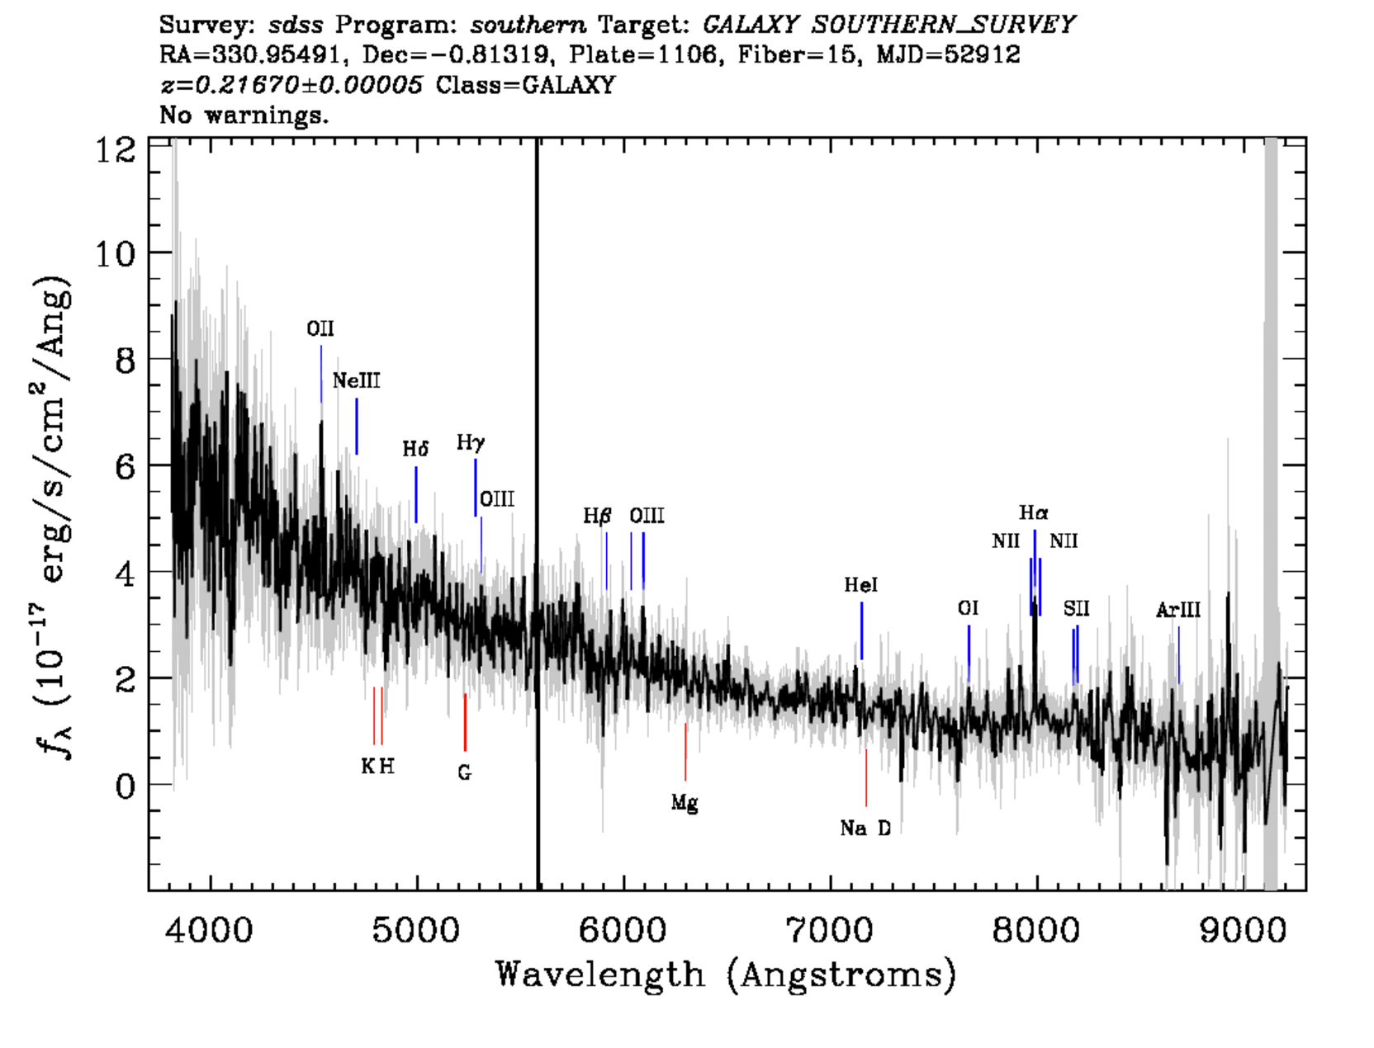
Cleaning DR 12 Pea Sample
Select ‘clean’ photometry flag (huge leap forward)
Issues still remaining: a couple in another galaxy,
a few with spectra missing OIII lines

Slide 17
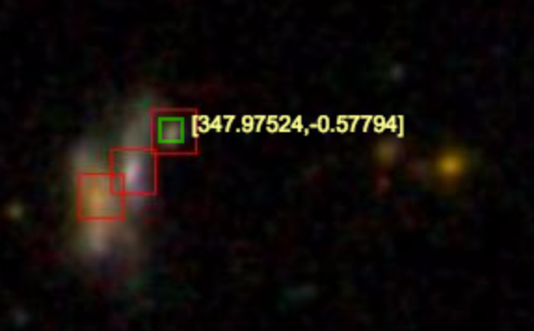
Cleaning DR 12 Pea Sample
Original Sample required A/N > 3
Looking at these images
I see lots with neighbors
Peas Search in DR12
DR12 (color & size): 4155
DR12 Portsmouth Group: 2203
DR12 Portsmouth Group SF: 1592
DR12 Portsmouth Group SF & clean phot: 1454
DR12 A/N gt 3 in all lines: 739

Slide 18
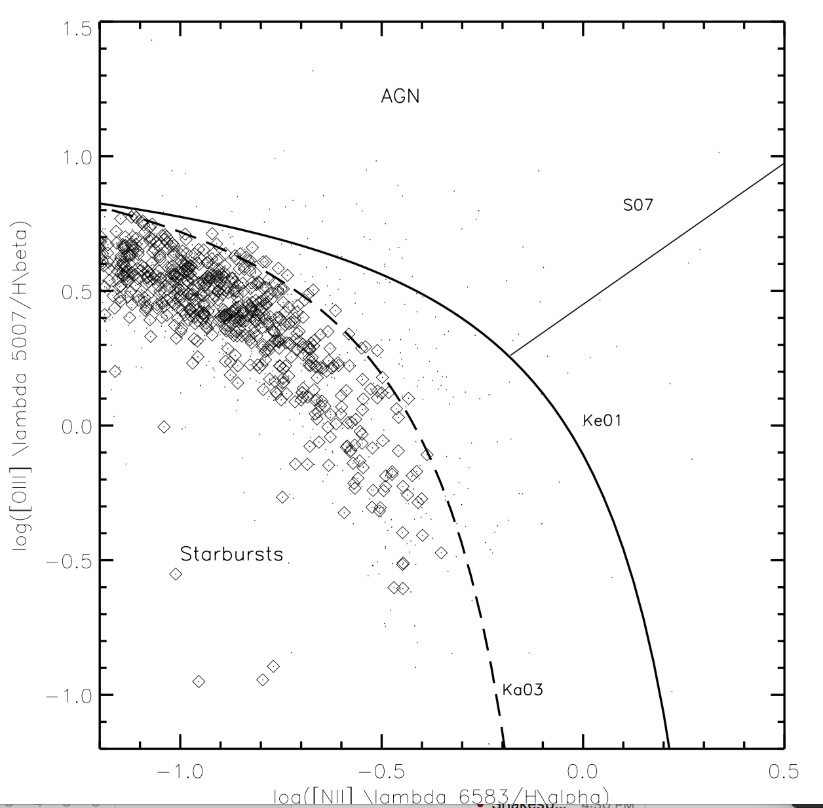

Slide 19
Neighbors w/out spec/photoz

Slide 20
Next (3) weeks
Finalize ‘new’ DR 12 Peas
Search for neighbors in DR 12 catalog (no z, photoz required)
Download HST images where available for comparison. Create HST gallery…

Slide 22
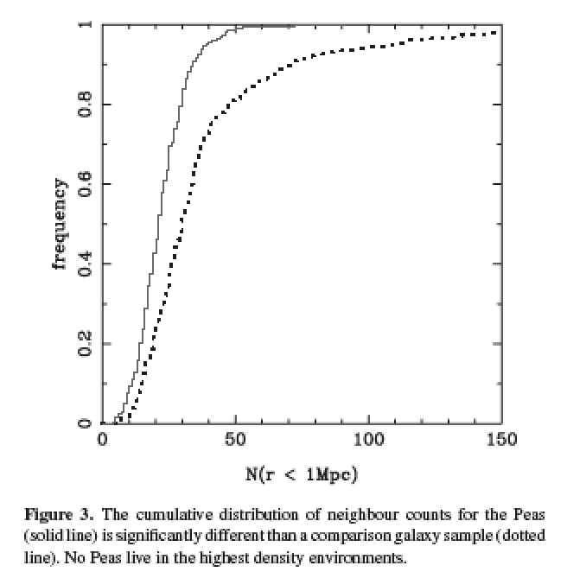
Cardamone et al. 2009
Projected density around Peas vs. sample matched in luminosity and redshift
Looked within projected 1Mpc, and imag > -20.5
Notes:
Projected density around Peas vs. sample matched in luminosity and redshift
Looked within 1Mpc, and imag > -20.5
Peas lie in lower density regions than typical gal at same i-band luminosity
KS test 8 sigma
Median environmental density less than 2/3rds normal galaxies

Slide 23
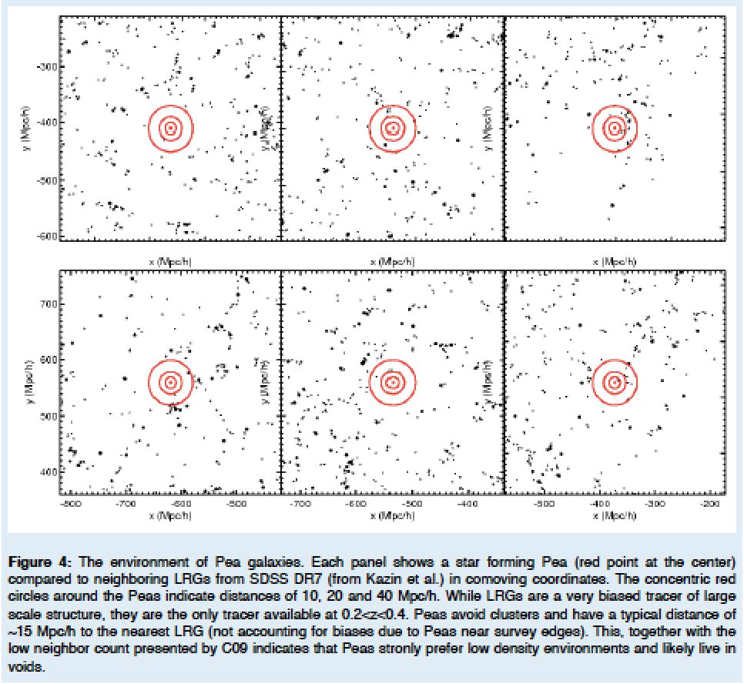
Kevin’s HST SNAP proposal / ~15 Mpc/h to nearest DR7 LRGs
Notes:
(10,20 & 40 Mpc/h) – red circles
Strongly prefer low density environments. . . .

Slide 24
Mapping Environment of Green Peas
Original idea – match peas to a Mock Universe
Looking at abundance matching
e.g., distance to 5th nearest neighbor (W/in Mstar)
e.g., distribution of Neighbors within 1/5 Mpc

Slide 25
Searching for Pea Neighbors
Starting with the original sample of 80 peas, looking within 50 Mpc projected
Neighbors found with specz 427
Neighbors in photometric catalog 120595
Neighbors found with photo redshift est 20743
Neighbors found w/ photoz in 1sig of pea z 9844
+ -> photo error class 1 3560
*** only a handful (35) remain if looking within 5 Mpc… ***

Slide 26
To Dos:
Compute 3D distance between a pea & a neighbor using redshifts (lumdist.pro)
Find a selection sample for 5th nearest neighbor . . .
Finalize DR12 selection of peas for follow-ups (still cleaning), figure out how to avoid galaxies!
Start learning compute.sciserver.org (Read in a catalog from casjobs)

Slide 27
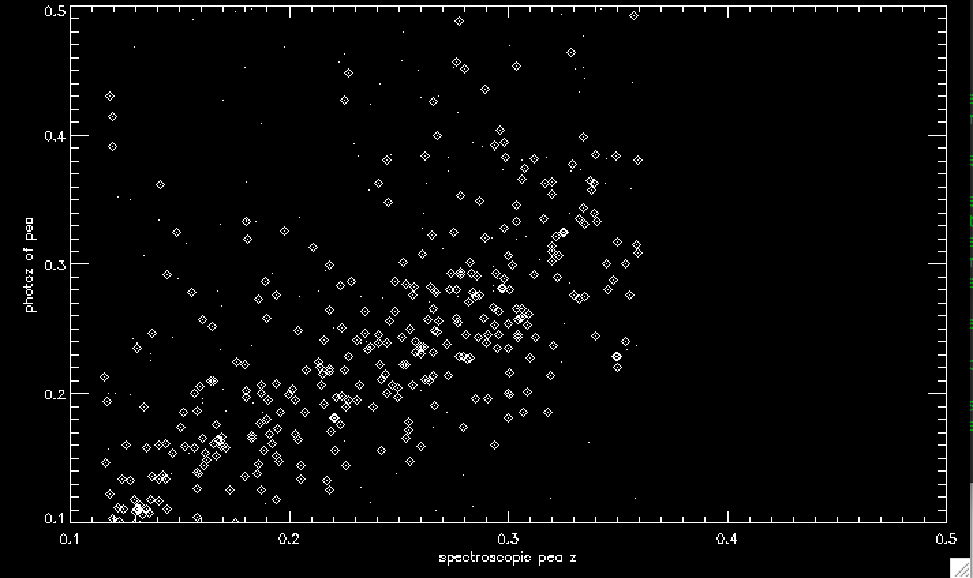
Photo-z catalog compared to spec for the DR12 Peas

Slide 28
Search for Peas in DR12
Original Sample was 251 in color, 80 SF spectra (9 stripe 82)
DR12 search 4155 in color / size / EW OIII
Portsmouth Gandalf fits: 2203
Star Forming BPT 1469 - 1346 w/ clean phot
(45 in Stripe 82)
Note this recovers 57 of the 80 original

Slide 29
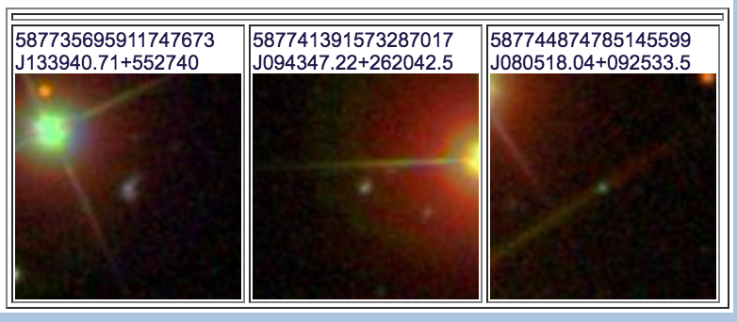
8 from Original 80 not recovered
3 BAD photometry – near bright objects….
2 not in Portsmouth Catalog
3 had EW < 0.5
15 Not classified as ‘Star Forming’ in BPT
(Seyfert, Composite, LINER)

Slide 30
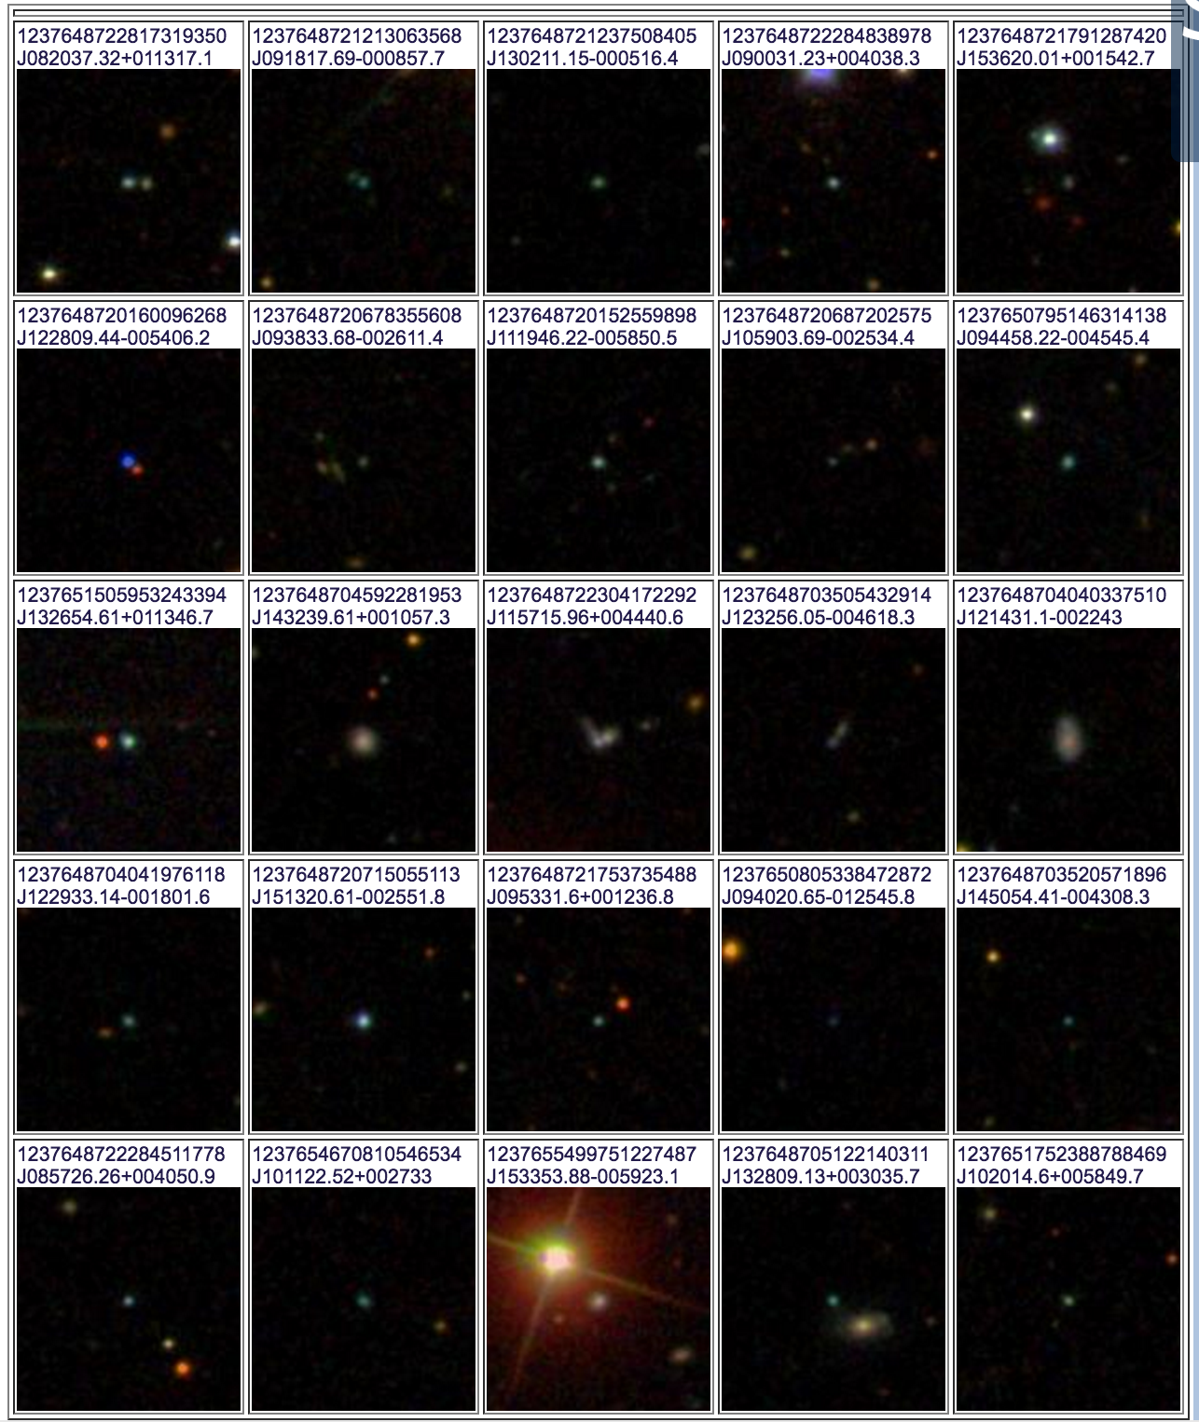
Images of DR 12 Peas Stripe 82

Slide 31
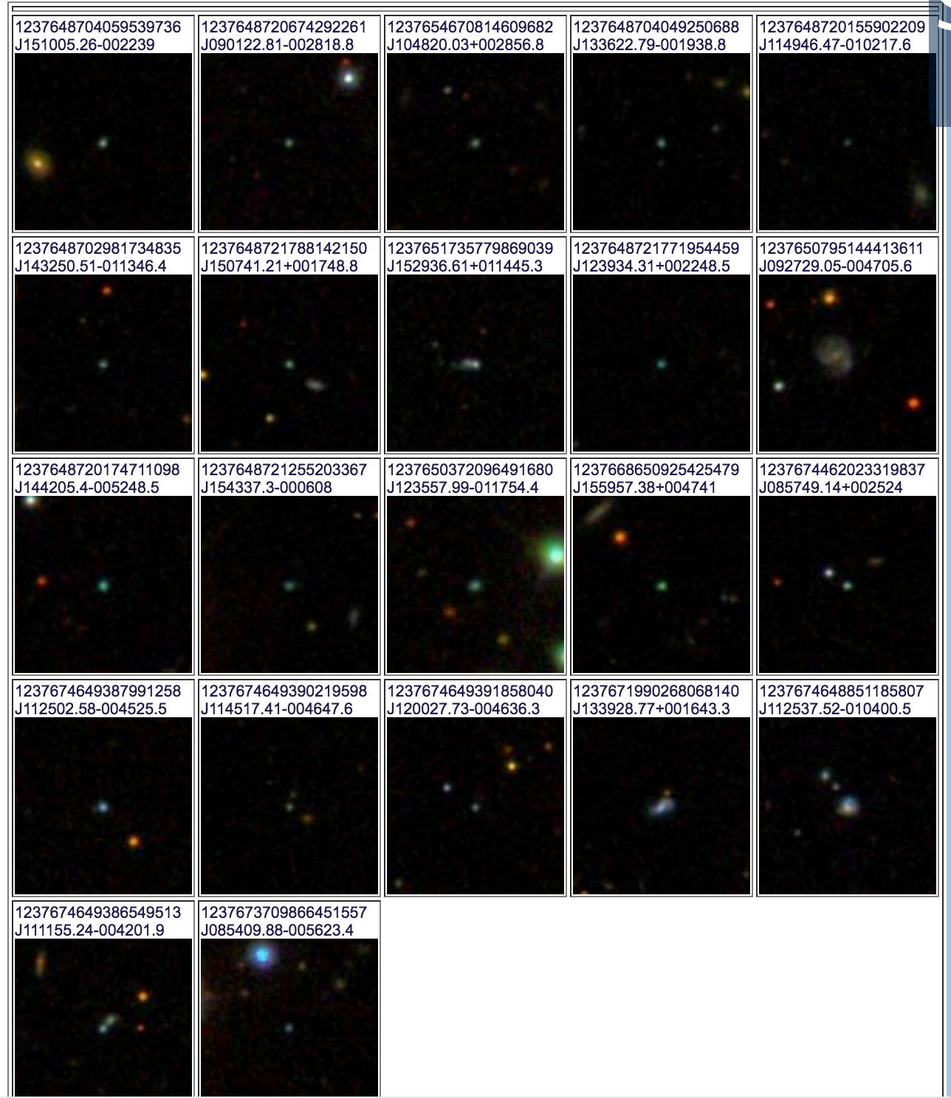
Images of peas Stripe 82

Slide 32
